Slide 1
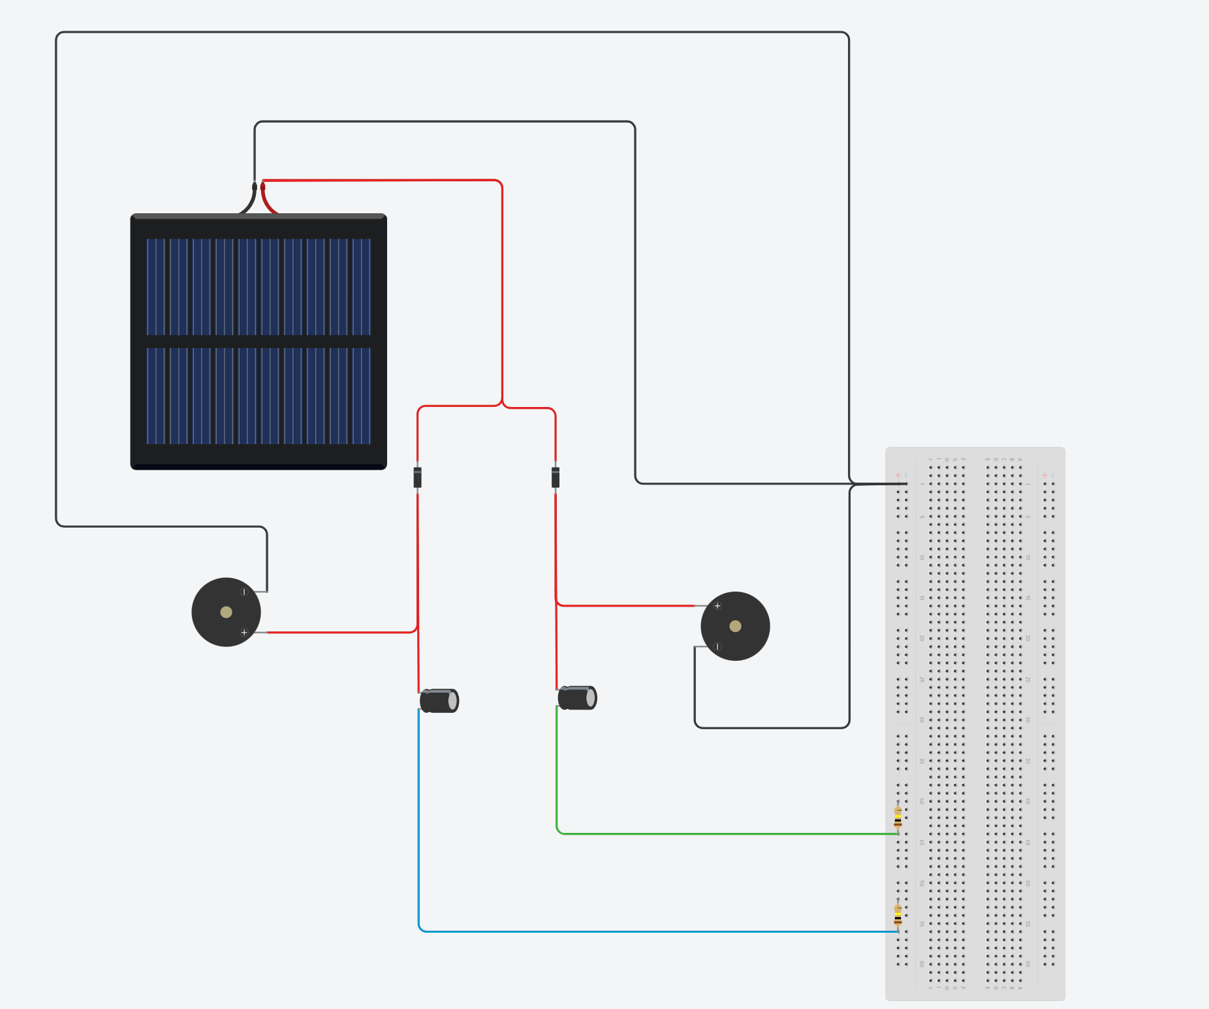
Power Supply
Current Regulating Diodes
LabJack
PCB Sensor
PCB Sensor
Polarized Capacitors
Pull-Down Resistors

